Slide 1
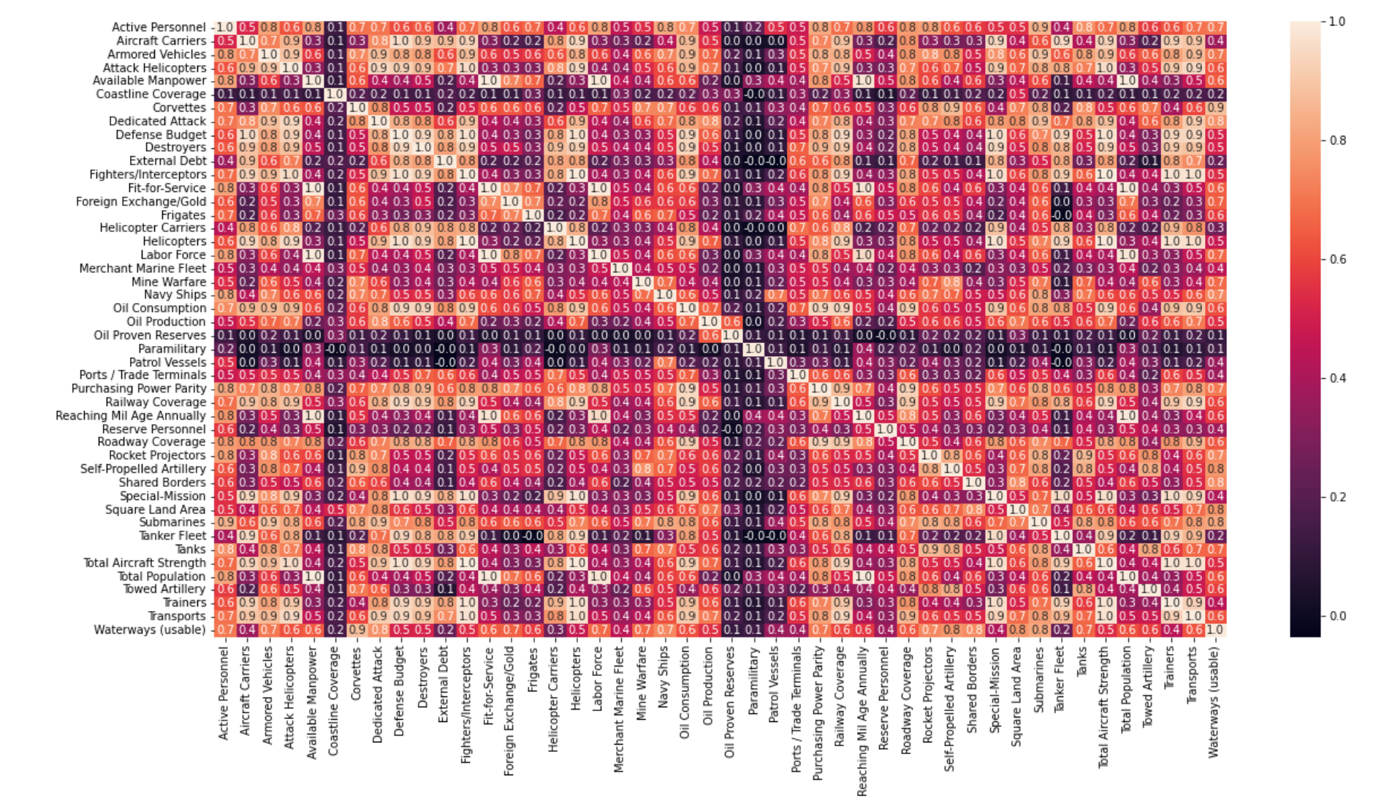
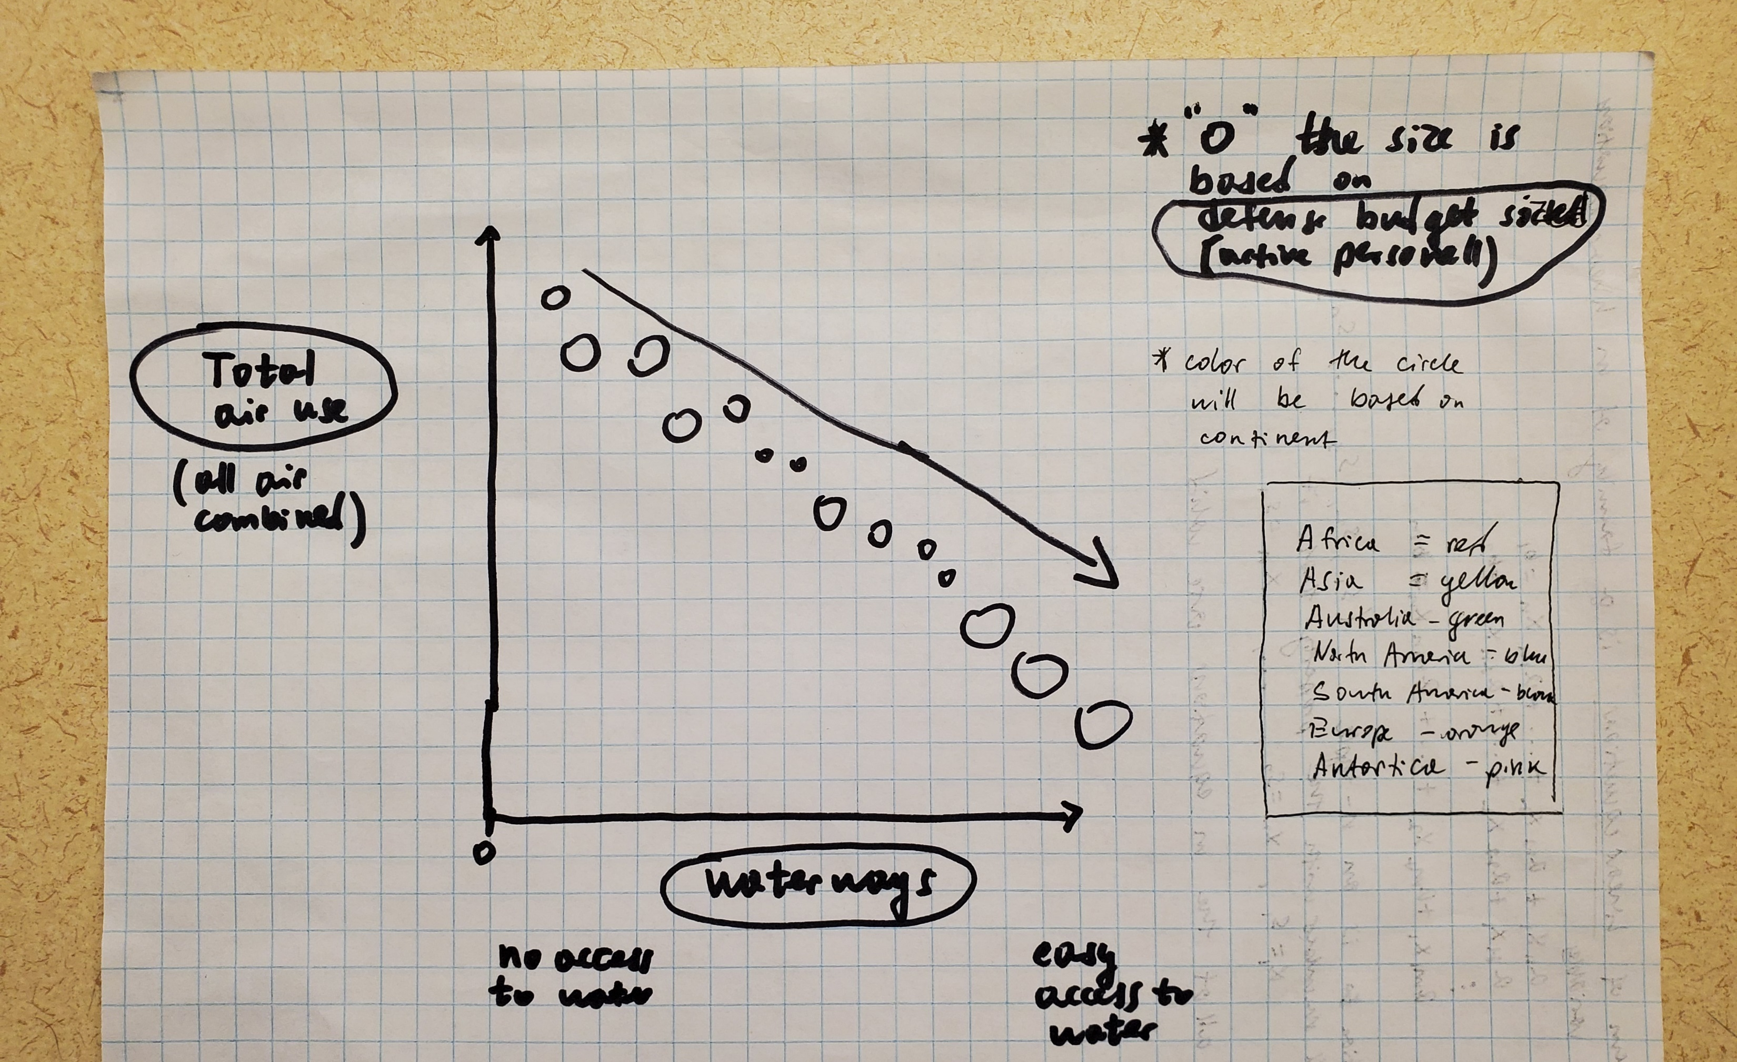
Data_Viz by Kirill P., Stuart G., Andrew S.
Sasakitetsuya, T. (2022, February 23). Top 20 defense budget countries analysis. Kaggle
Recreate with only 5 variables
Country
Waterways
Total Air Power
Defense Budget
Active Personnel

Slide 2
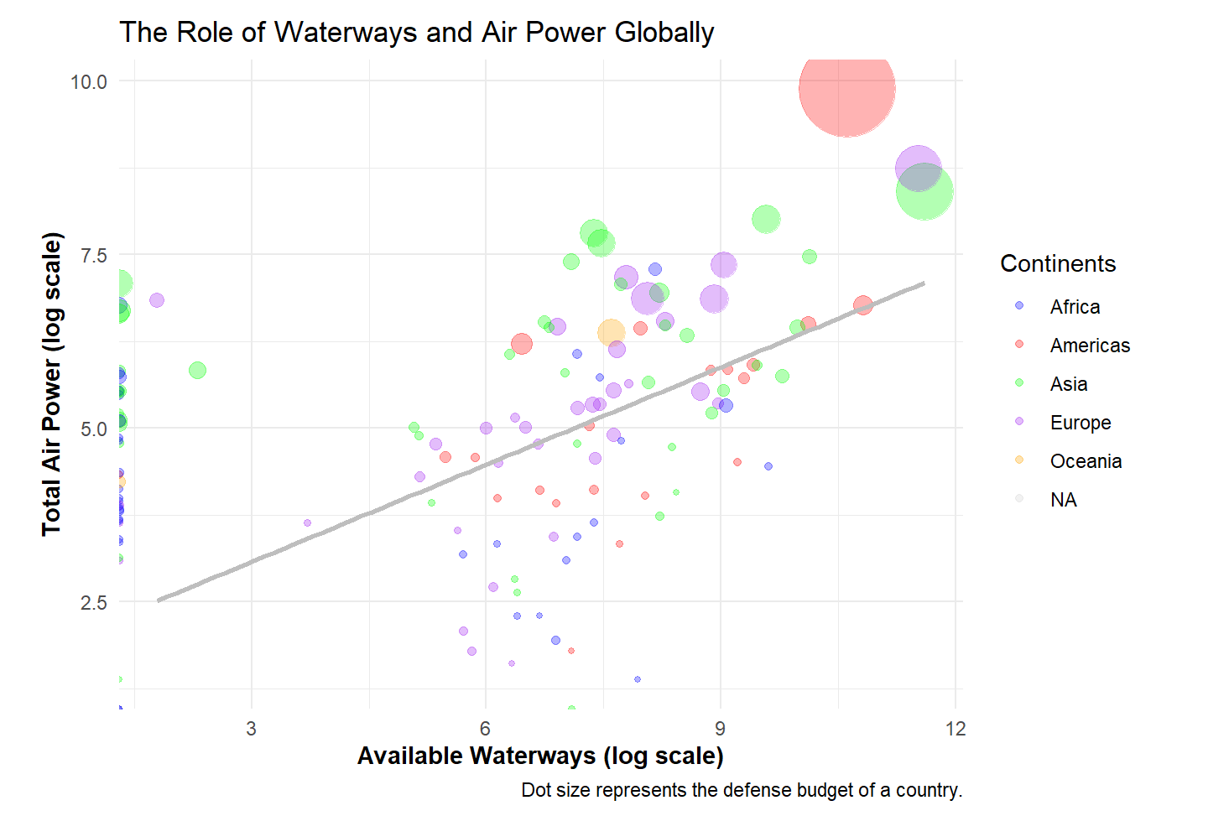
Our Graph

Slide 3
Process and Challenges
Coming up with the story…making it interesting
Complicated graph
Scatter plot
Each dot is sized based on the defense budget
Properly displaying the distribution/scale of data

